Slide 1


Bank of Baroda Hackathon - 2022
Technology Partner
Your Team Name :Nova
Your team bio :
Sethu Institute Technology- CSE Department
Date :17/09/2022

Slide 2
Problem Statement?
Why did you decide to solve this Problem statement?
Comparing to the other problem cases we have innovative idea in ALTERNATE AUTHENTICATION.
We have concentrated to improve the securities over the authentication processes in banks,because these are the major crisis we are facing on authentication in recent days.
As we all know, cyber attacks has been spiraling complications in banking.
The financial industry stands out among these as one with a great deal of sensitive and valuable information for attackers to target and numerous potential opportunities for cyber criminals to get Profit from these attacks.

Slide 3
User Segment & Pain Points
Which user /advertiser segment would be early adopter of your product & why?
We all know that authentication plays vital role in protecting credentials.
The sector of the economy mandatorly needs authentication which includes financial institutions such as banks,investments,business etc…
Due to the scale and complexity of insurance industry,as well as huge volume of data used by enterprises ,authentication is critical in this sector.
Insurance company become more vulnerable to all kind of cyber attacks , data theft , the only way to overcome these issues is secured authentication.

Slide 4
Pre-Requisite
What are the alternatives/competitive products for the problem you are solving?
Security patterns can be applied to achieve goals in the area of security.
All of the classical design patterns have different instantiation to fulfill some information security goals.
The ultimate goal of grid-phrase authentication is to reduce the liability of current authentication technique.

Slide 5
Azure tools or resources
Azure tools or resources which are likely to be used by you for the prototype, if your idea gets selected
In financial sectors , the maintenances and safety of data is needed in huge .
Using Azure AI tools , these needs can be done. It will Identify suspicious behavior and access risk while staying fully compliant with changing regulatory measures.
In this project the azure AI tools plays a major part in transferring the data with speed and security of the cloud .
Offers differentiated costumer experiences , enhance risk management , and power to fight frauds.
It can help us to store secured data of user for the authentication and access of the banking process.

Slide 6
Any Supporting Functional Documents
Present your solution, talk about methodology, architecture & scalability
The user usually uses a password to avoid the attacks like a dictionary attack, brute force attack and shoulder surfing attack which is the famous attack nowadays. The shoulder surfing attack is a direct observation technique by watching over the user’s shoulder when they enter their password to get information.
The most common authentication method used by the user is textual password. But, the textual password has many disadvantages because it is vulnerable to attack as it tends to shoulder surfing attack. The aim of this project is to overcome the above issue by developing grid-phrase authentication.
Using this scheme, user has a unique way of pattern in a grid. By using the phrase, user have to form that unique pattern. . This method is suitable to minimizing shoulder surfing attack as it can improve the security of user’s password and they can efficiently login to the system.

Slide 7
AUTHENTICATION
Authentication is the process where the identity of a person or a thing is verified. It is also the way for confirming the truth whether the attribute of data claimed by an entity is valid or not.
There are three types of authentication technique .
The first type of authentication is accepting the proof of identity given by a trusted person who has evidence of the said character , the originator.
The second type of authentication is comparing the attributes of the object itself to what is known about objects of that origin.
The third type of authentication relies on documentation or other external affirmations.

Slide 8
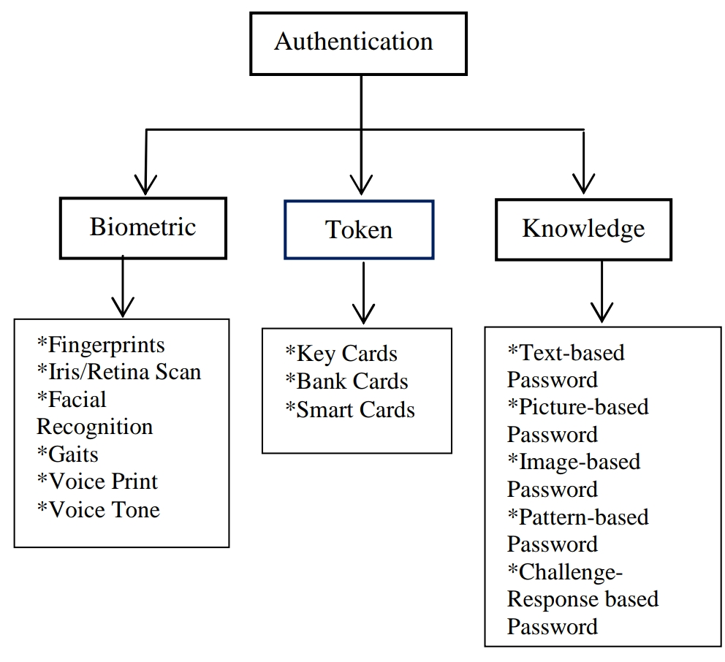
Taxonomy of Authentication
Taxonomy of User Authentication

Slide 9
Material and Methods
In this session ,The two techniques that are to be combined to produce our newly hybridized technique to form the full set of our authentication system.
Grid selection technique
Phrase technique
These techniques are grid selection technique which is used during the user registration session and Remember Phrase technique which is used during the user login session.

Slide 10
Grid Selection Technique (Registration)
The grid selection technique is an initially massive, fine-grained grid from which the user selects a drawing grid, a rectangular region which is lifetime unique pattern for every individual user.
In our authentication system, grid selection technique is used by the user during the registration phase.
There will be an empty grid given for the user to choose their unique pattern .
The user can choose whatever pattern or styles they want as they wish .
There is no limit for the user to select how many grids they like to choose their password as shown in fig 1.

Slide 11
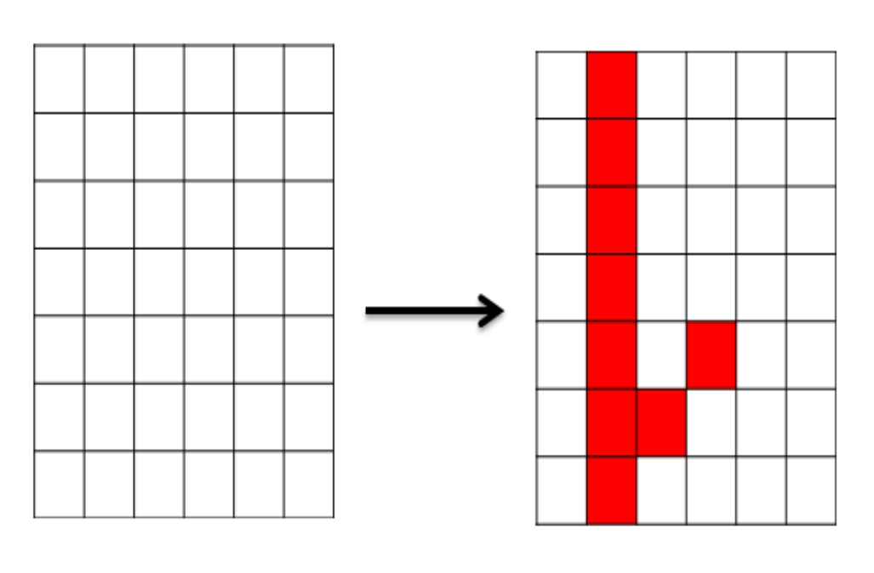
Fig.1

Slide 12
Phrase Remember Authentication
A particular number of phrases is generated randomly by authorized algorithm and given to the user which is usually a unique for every individual for the life time.
These random phrases wasn’t Inter-Related with each other.
Phrase is used by the user during the login phase of our authentication system.
By simply remember the phrase, we can authenticate ourself.

Slide 13
Collection of phrases
Dinosaur
Lame
Section
Involve
Champion
Seven
Poverty
Seat
Dumb
Cola
Bag
Innovate

Slide 14
Alternate Authentication
Grid-Phrase Authentication ( Hybrid technique )
In this project, we are altogether to introduce our alternate way of authentication.
Grid-Phrase Authentication is a new technique for authenticate banking systems or any sectors.
As we mentioned above , The Unique pattern chosen by user is filled with given phrase orderly.
If the pattern and phrase is matched perfectly with identity , the user gets the authentication to access the whole process.
By using following algorithm , we can develop it as a prototype working model.
User has only 3 trails to authenticate the correct phrase pattern.

Slide 15
Cola
Bag
Dinosaur
Section
Champion
Involve
Poverty
Innovate
Seven
Seat
Dumb
Lame

Slide 16
Algorithm
It involves the real development of the authentication system based on the previous phase.
To develop the authentication system, the coding will be developed before the system goes through the testing phase using the PHP language.
First, if the user is new to the system and still did not register, he/she is required to do so.
During registration, the user needs to enter a username, e-mail and choose the pattern password .
The unique phrase is given to the users using the random phrase generating algorithm.
All the details then will be saved into the database . Otherwise, if the user has already registered, he can proceed to login into the system.

Slide 17
During the login process, the user only needs to enter a username and grid-phrase based password.
Then, the system will compare the username and grid-phrase based password that is dragged and entered by the user and compare it with the one created and stored in the database.
If the login is a success as a result of the user entering the correct username and textual password, then the user authentication is successful.

Slide 18
Flowchart
start
user
Enter username and choose pattern
no
Register
yes
login
Enter username
Incorrect username or pattern or phrase
no
Drag a phrase and drop it by pattern
Username and pattern-phrase verification
Authentication
End

Slide 19
IDEA’S DEVELOPING ALGORITHM
First, we have to connect a grid by using front end development (Hypertext Machine Language) which is used to structure a web page or its content.
Phrase also design by front end developing architecture.
Initialization of cells in a grid precedes in OFF-state, when the cells get filled by phrase , it get swapped into ON-state.
The pattern and phrase is verified with existing data in database by using python.
If the pattern and phrase is correct , then it allows the user to access the further process.
If its not matched with existing data from database, then user have to re-enter correct information in login phase.

Slide 20
Key Differentiators & Adoption Plan
How is your solution better than alternatives and how do you plan to build adoption?
Text based authentication technique has many disadvantages. User can have passwords, which can be guessed easily .
If user has a password which is difficult to guess, it may be hard for user to remember it. Also user can be a victim of dictionary attack, spyware, and brute-force attack.
By this project, it will be a great help indeed to computer users in preventing personal asset from being stolen by their adversaries. Classical authentication techniques are prone to various attacks.
The proposed solution caters the issue of shoulder surfing attacks which could easily be conducted when using the text-based password.

Slide 21
GitHub Repository Link & supporting diagrams, screenshots, if any
How far it can go?
Authentication is used by a server when the server needs to know exactly who is accsessing their information site.
The escalation in data theft leads to improve the efficiency of authentication.
The goal of our grid-phrase authentication is to reduce the rate of FAR (False Acceptance Rate) and FRR (False Rejection rate).

Slide 22
Thank You
Jaya Darshini N
Kamalishree M
Hariram Pandiyaraman
Arjun TM

